Slide 1

Probability Distributions

Slide 2
Objectives
The basic concepts probability and probability distributions
The basic application of probability and probability distributions
Probability Distributions

Slide 3
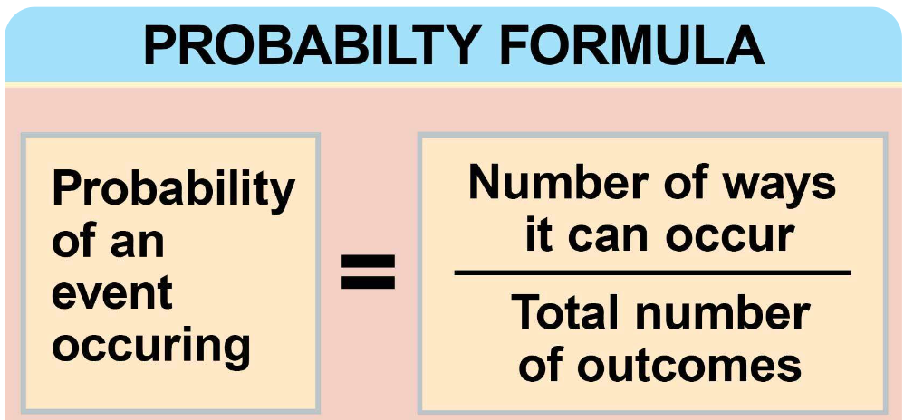
Probability
Probability is a measure between zero and one for the likelihood that something or some event might occur
  the stock markets, the chance of stock market's rising above some point, or falling below some point is x%, or you may hear that the chance for rain is 45% tonight.
  Probability is a measure between zero and one, so 45% would be 0.45,
Probability Distributions

Slide 4
Random variables
Random variable is a quantity whose possible values depend in some clearly defined way on a set of some random events.
  It's a function that maps out outcomes, that is, points in a probability space.
  Probability space essentially is all possible outcomes, If you roll a die, it can have one out of six outcomes, so that's the probability space there.
  If you roll two dice, you can have one out of 36 outcomes where each outcome could be considered a random outcome
Probability Distributions

Slide 5
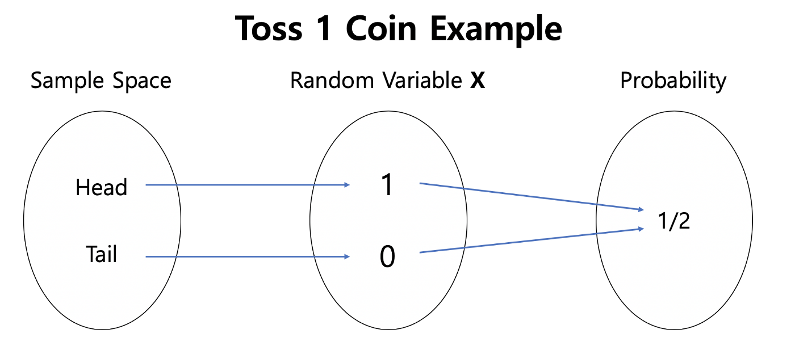
Random variables
Probability Distributions

Slide 6
Probability distribution
Probability distribution: depicts the possible values any random variable may assume along with the probability of its occurrence
A probability distribution: describes all the possible values and likelihoods that a random variable can take within a given range.
This range: between the minimum and maximum possible values.
These factors include the distribution's mean (average), standard deviation, skewness, and kurtosis.
Probability Distributions
Notes:
This range will be bounded between the minimum and maximum possible values, but precisely where the possible value is likely to be plotted on the probability distribution depends on a number of factors.

Slide 7
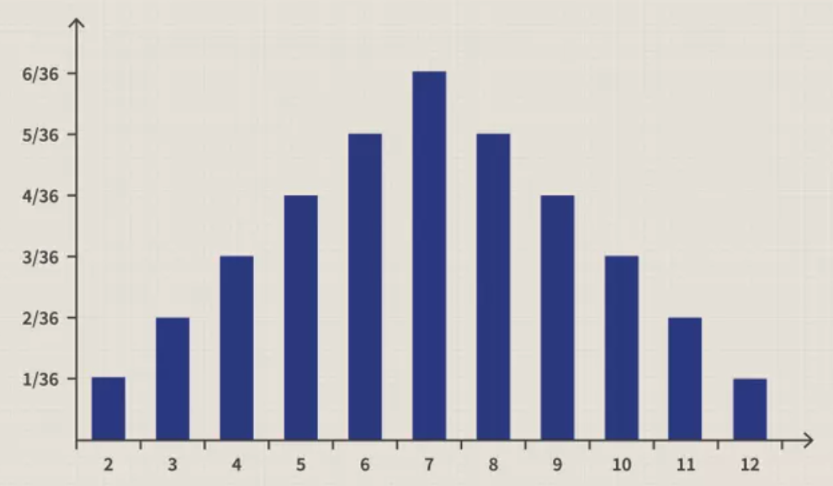
Probability distribution
Rolling two standard six-sided dice
Probability Distributions

Slide 8
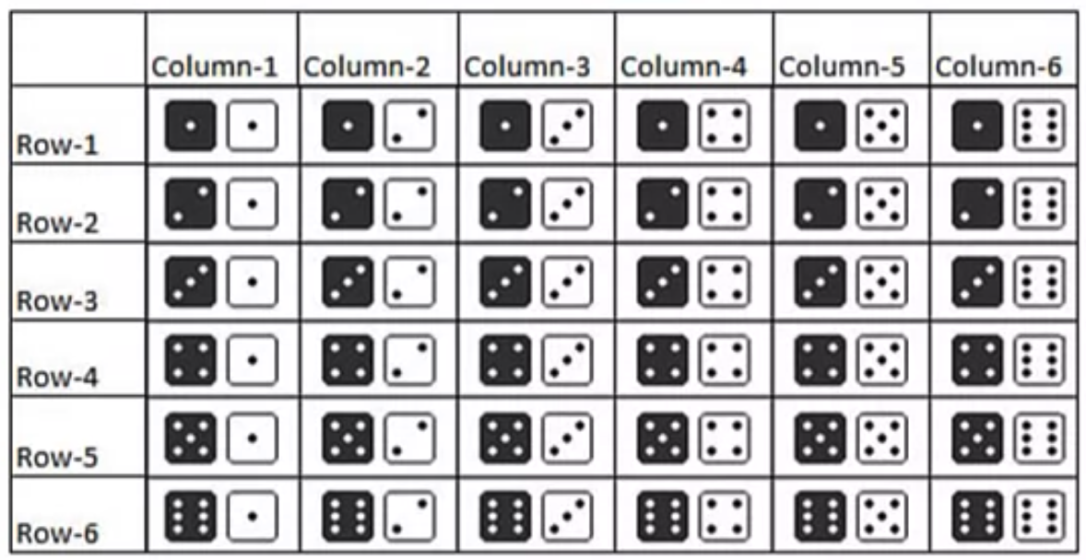
Probability distribution
All possible outcome of rolling two dice
Probability Distributions

Slide 9
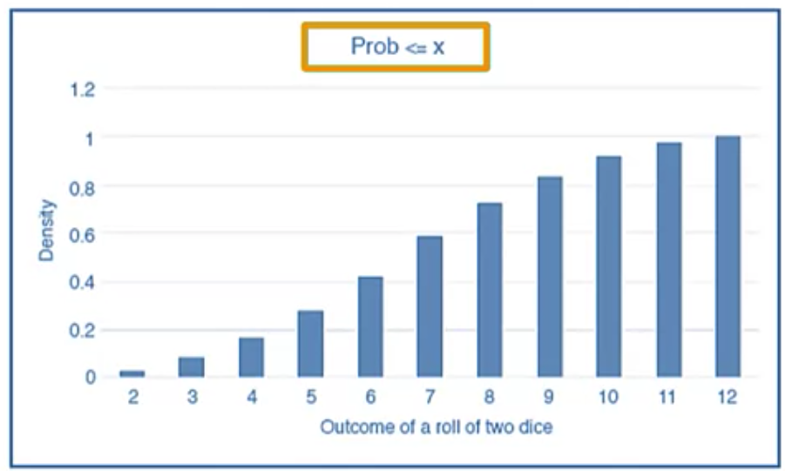
Probability distribution
if I were to look at the probability of say, getting some number or less than some number, that's called the cumulative distribution function
Probability Distributions

Slide 10
Summary
Understand the basic concepts probability and probability distributions
Understand the basic application of probability and probability distributions
Probability Distributions

Slide 11
Q & A
Probability Distributions

